Slide 1
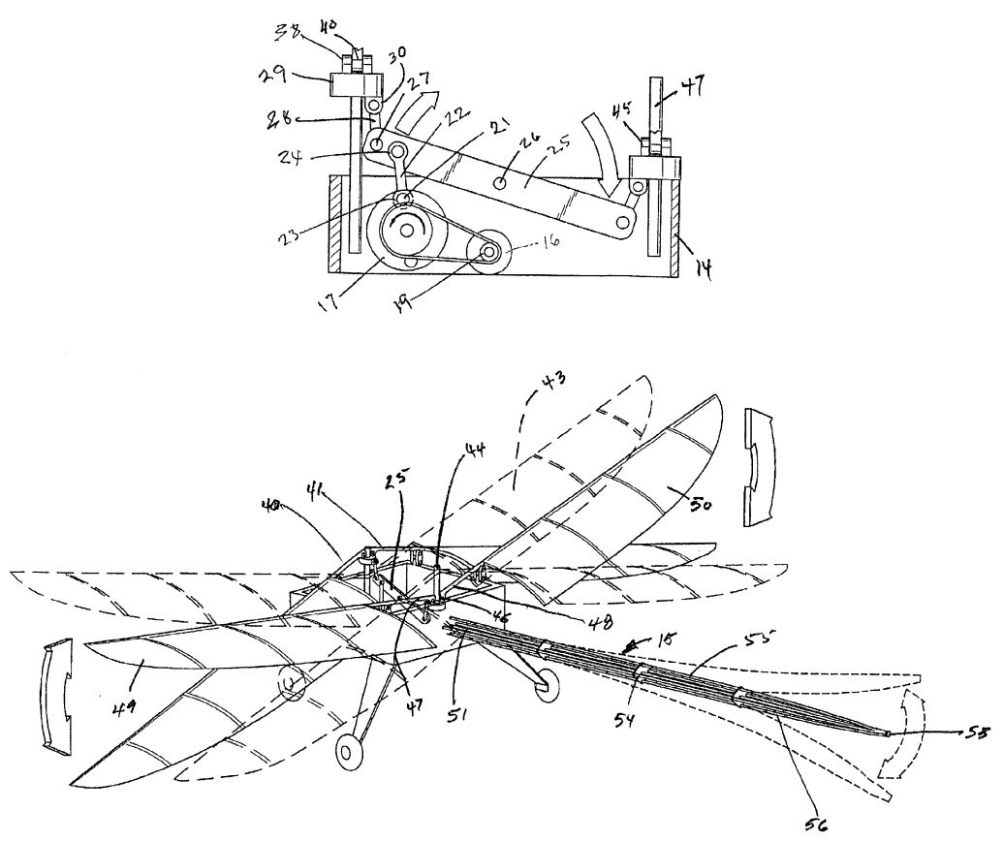
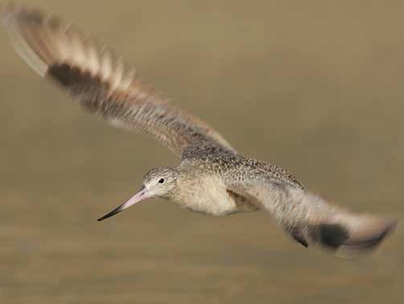
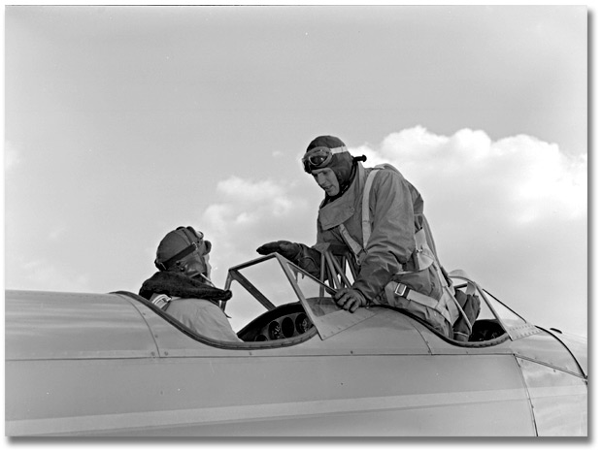
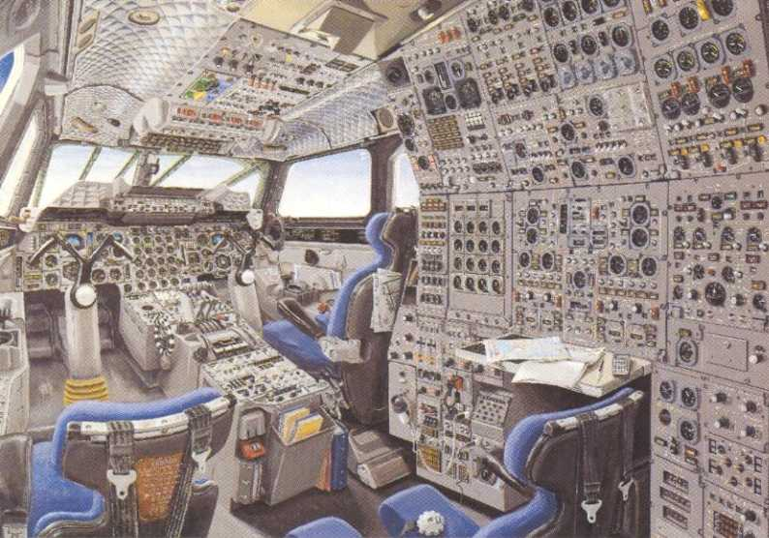
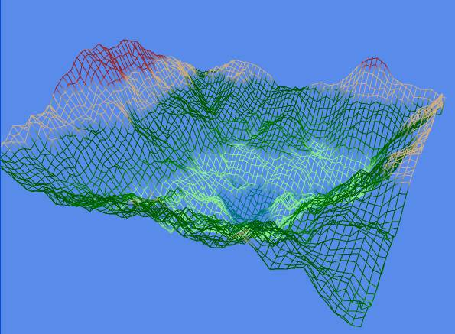

Chris, Laurent, Even, Jean, and @
Wish a smooth coding
voiid CVehicleObject::UpdateMotionState(float dT) {
double m = GetMass();
CVector J(*(GetMomentOfInertia()));
// current state becomes previous state
prv = cur;
cur = (cur+1)&1;
// angular acceleration
dw[cur].x = ((J.y - J.z)*w[prv].y*w[prv].z + tb.x)/J.x;
dw[cur].y = ((J.z - J.x)*w[prv].z*w[prv].x + tb.y)/J.y;
dw[cur].z = ((J.x - J.y)*w[prv].x*w[prv].y + tb.z)/J.z;
// angular velocity
w[cur] = w[prv];
w[cur].Integrate(dT, dw[cur], dw[prv]);
// orientation
q.GetDerivative(dq[cur], w[cur]);
q.Integrate(dT, dq[cur], dq[prv]);
// linear acceleration
i2b.TransformBtoI(a[cur], fb);
if (m) a[cur].Times(1/m); // a = F/m
// linear velocity
v[cur] = v[prv];
v[cur].Integrate(dT, a[cur], a[prv]);
// position
ifpos.Integrate(dT, v[cur], v[prv]);
// update secondary representations of orientation
q.GetRotMatrix(i2b);
i2b.GetEulerAngles(eulerAngles);
//! iang
CVector tmp_iang;
lf_.euler2iang (eulerAngles, CWorldObject::GetPosition(), tmp_iang); // according Even's pos-euler.xls excel sheet
//! geop
SPosition tmp_geop;
lf_.ipos2geop (ifpos, tmp_geop); // according Even's ipos2geop.xls excel sheet
// adjust position and orientation
CWorldObject::SetPosition (tmp_geop);
CWorldObject::SetOrientation (tmp_iang);
}
towards the Fly! Legacy
development team
Frank Dhont (EBKT) 01 / 11 / 2007

